Slide 1




LOGO
UNIV/POLTEK
DTS 2019: Internet of Things
#27 Data Visualization
digitalent.kominfo.go.id

Slide 2
Agenda
Data Visualization
ThingsBoard Widget

Slide 3
Data Visualization

Slide 4
Data Visualization
ThingsBoard allows you to configure customizable IoT dashboards.
Each IoT Dashboard may contain multiple dashboard widgets that visualize data from multiple IoT devices.
Once IoT Dashboard is created, you may assign it to one of the customers of you IoT project.

Slide 5
ThingsBoard Dashboard
IoT Dashboards are light-weight and you may have millions of dashboards.
For example, you may automatically create a dashboard for each new customer based on data from registered customer IoT devices.
Or you may modify dashboard via script when a new device is assigned to a customer. All these actions may be done manually or automated via REST API.

Slide 6
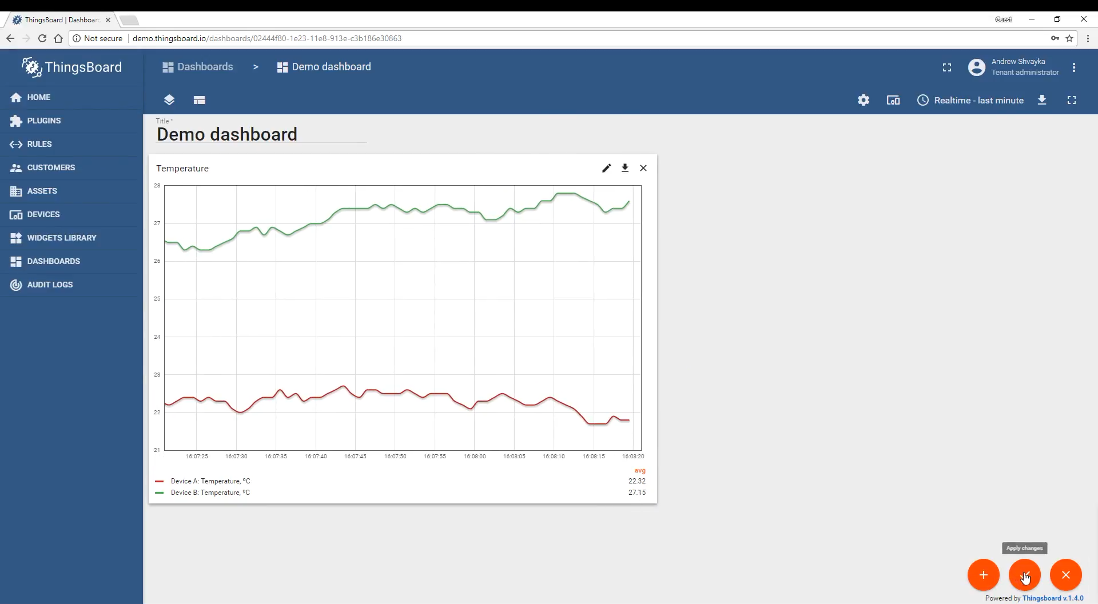
ThingsBoard Dashboard

Slide 7
Widgets Library

Slide 8
Widgets Library
All IoT Dashboards are constructed using ThingsBoard widgets that are defined in Widget Library.
Each widget provides end-user functions such as data visualization, remote device control, alarms management and displaying static custom html content.

Slide 9
Widget Types
According to the provided features, each widget definition represents specific widget type. At the moment there are five widget types:
Latest values
Time-series
RPC (Control widget)
Alarm widget
Static

Slide 10
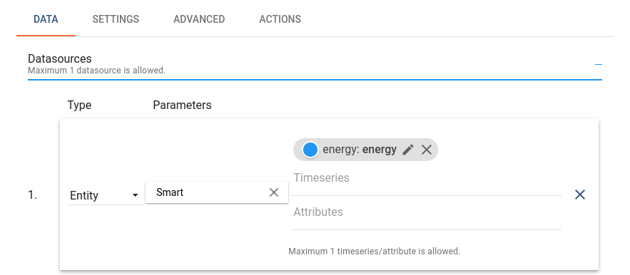
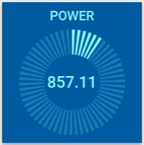
Latest Values
Displays latest values of particular entity attribute or timeseries data point (for ex. any Gauge Widget or Entities Table widget).
This kind of widgets uses values of entity attribute(s) or timeseries as datasource.

Slide 11
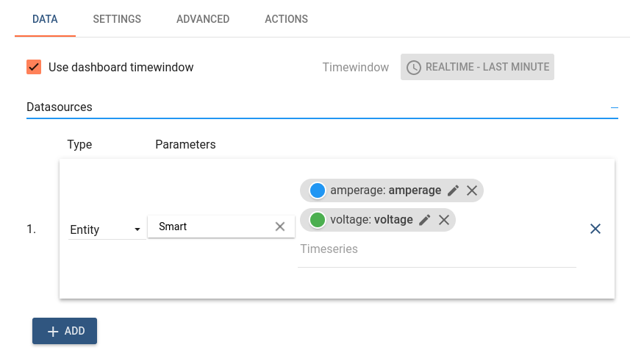
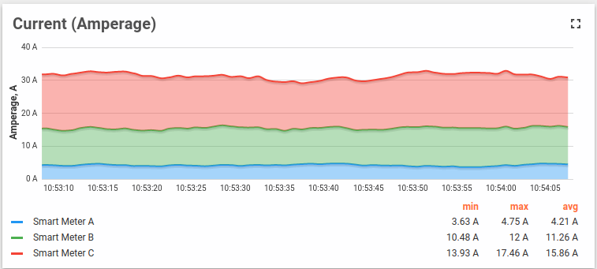
Time-series
Displays historical values for the selected time period or latest values in the certain time window (for ex. “Timeseries - Flot” or “Timeseries table”).
This kind of widgets uses only values of entity timeseries as datasource. In order to specify the time frame of displayed values, Timewindow settings are used.

Slide 12
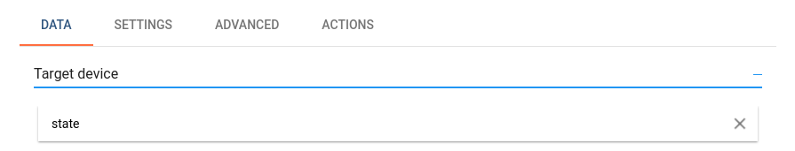
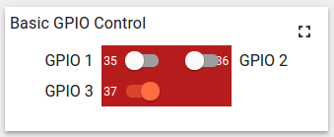
RPC (Control widget)
Allows to send RPC commands to devices and handles/visualize reply from the device (for ex. “Raspberry Pi GPIO Control”).
RPC widgets are configured by specifying target device as target endpoint for RPC commands.

Slide 13
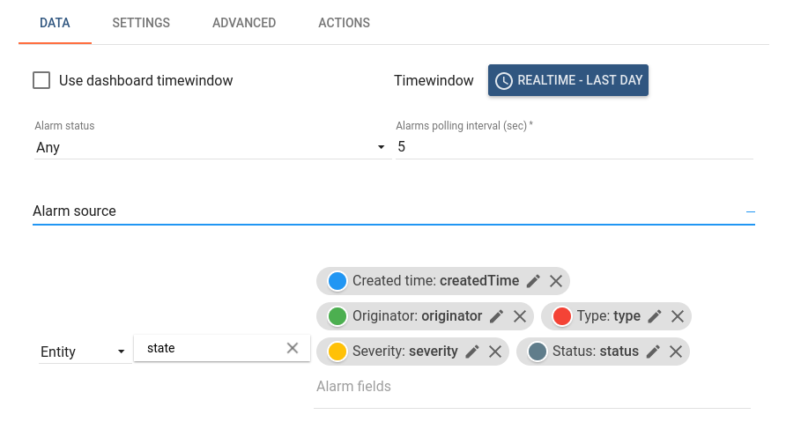
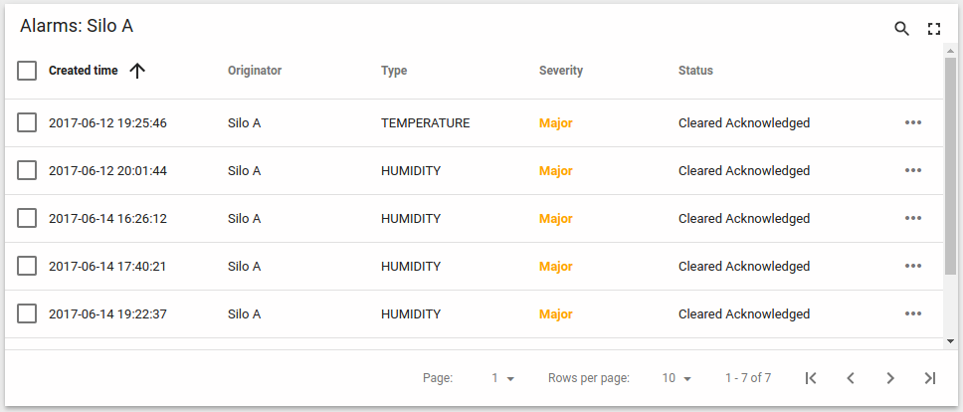
Alarm Widget
Display alarms related to the specified entity in the certain time window (for ex. “Alarms table”).
Alarm widgets are configured by specifying entity as alarms source and corresponding alarm fields.

Slide 14
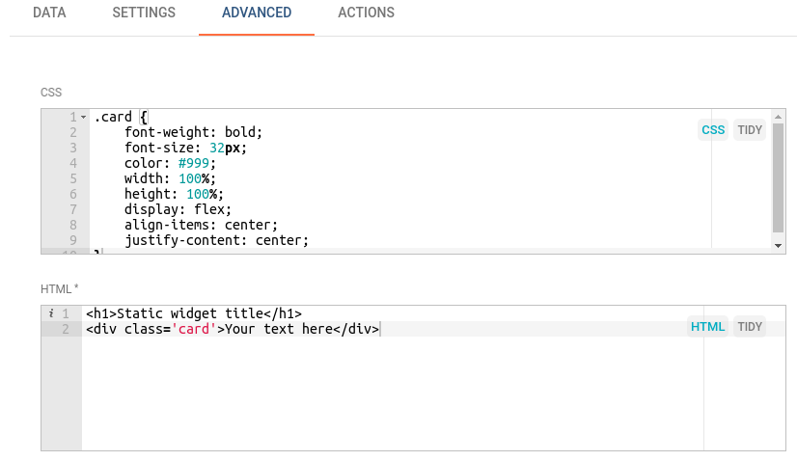
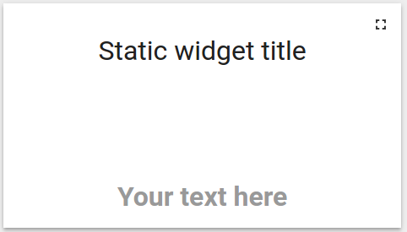
Static
Displays static customizable html content (for ex. “HTML card”).
Static widgets don’t use any datasources and usually configured by specifying static html content and optionally css styles.

Slide 15
Widgets Library

Slide 16
Widgets Library
Widget definitions are grouped into widget bundles according to their purpose.
There are System level and Tenant level Widgets Bundles.
Initial ThingsBoard installation is shipped with the basic set of system level Widgets Bundles.

Slide 17
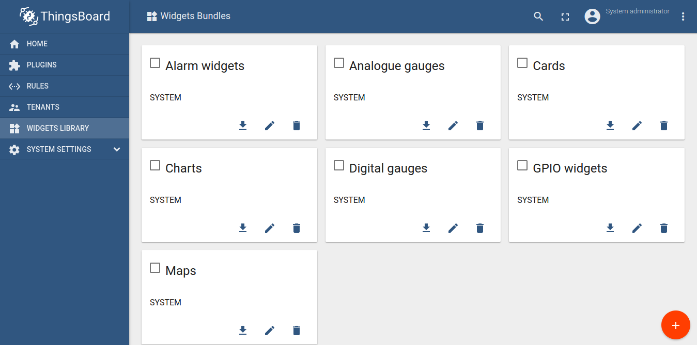
Widgets Library

Slide 18
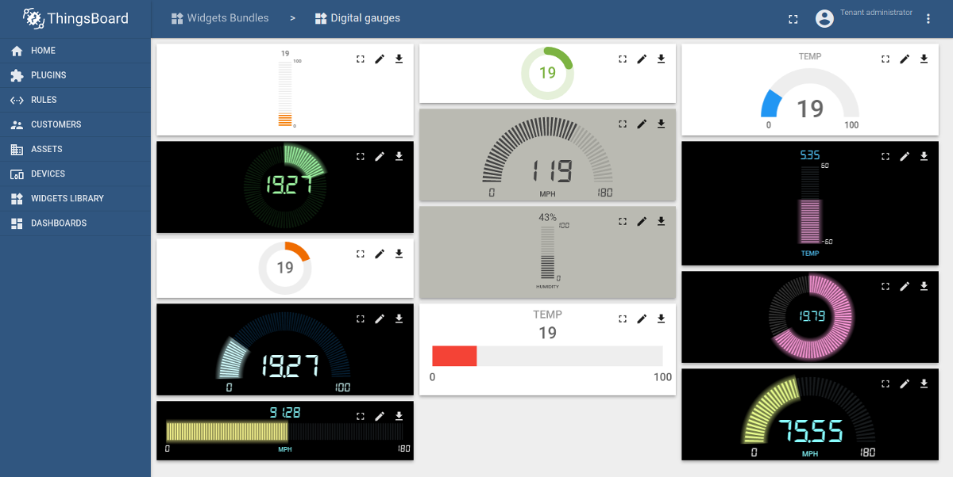
Digital Gauges
Useful for visualization of temperature, humidity, speed and other integer or float values.

Slide 19
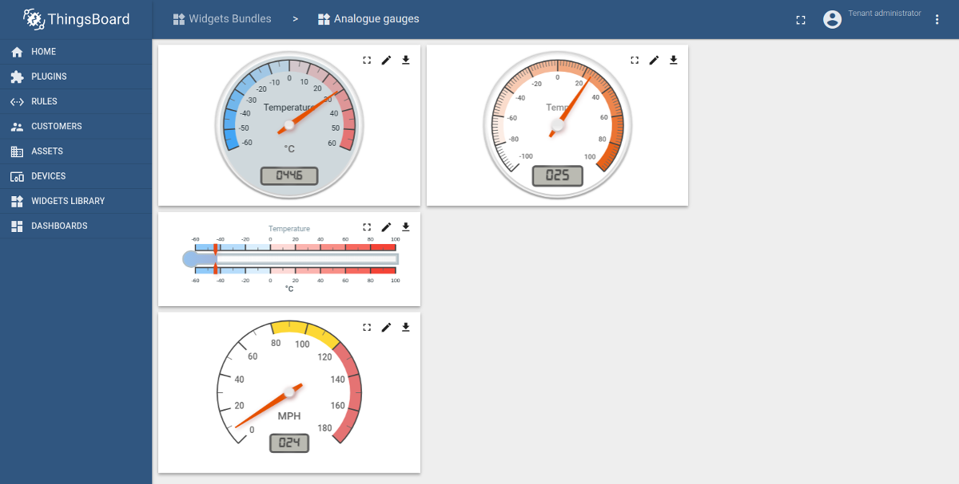
Analog Gauges
Similar to digital gauges, but have a different style.

Slide 20
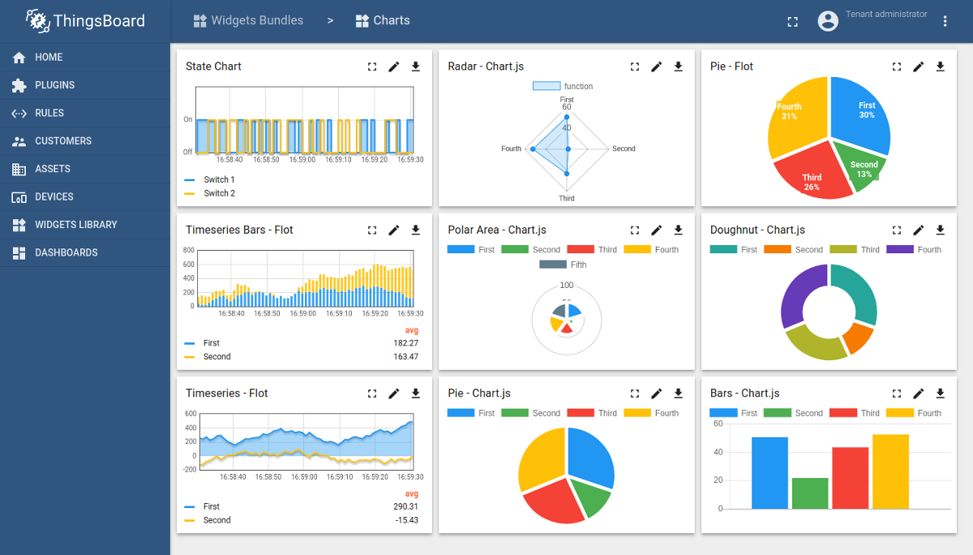
Charts
Useful for visualization of historical or real-time data with a time window.

Slide 21
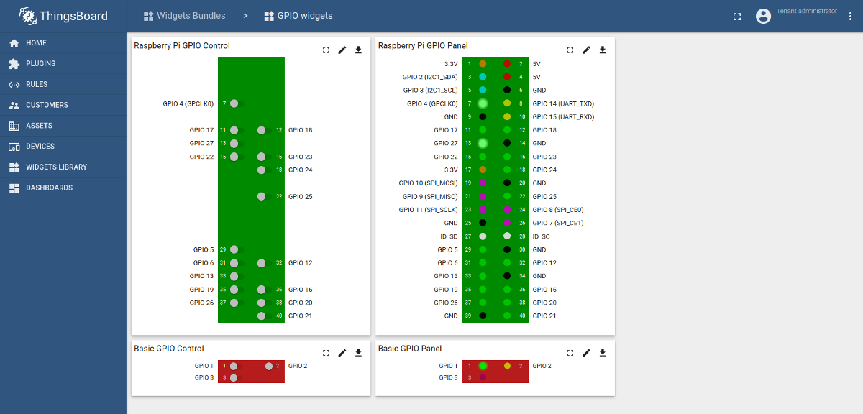
GPIO Widgets
Useful for visualization and control of GPIO state for target devices.

Slide 22
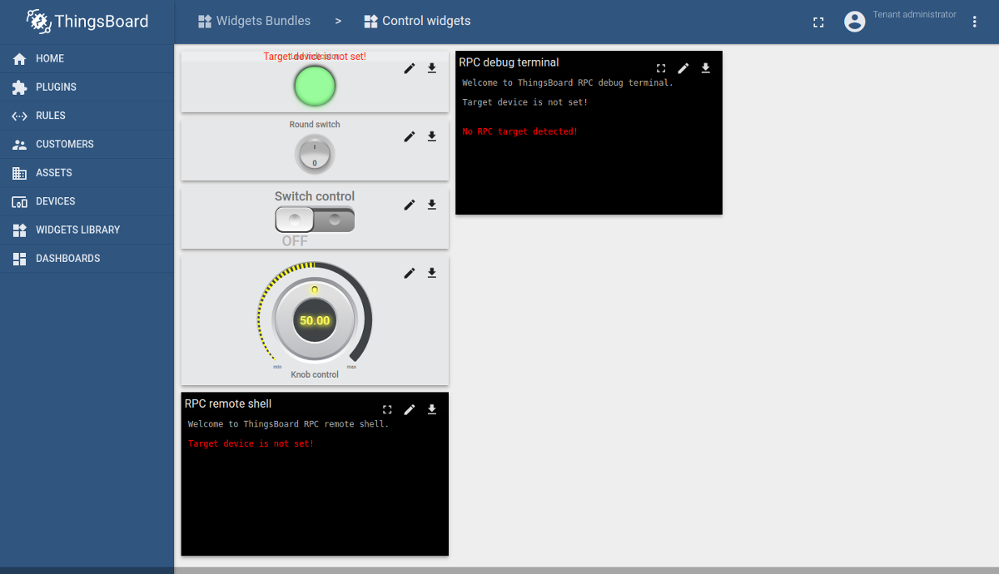
Control Widgets
Useful for visualization of current state and sending RPC commands to target devices.

Slide 23
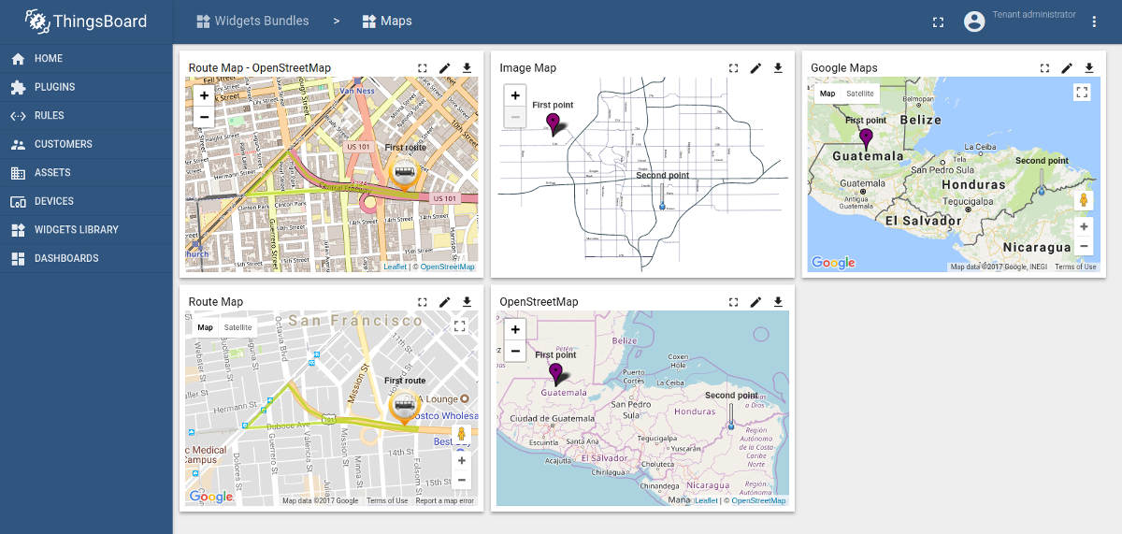
Maps Widgets
Useful for visualization of devices geo locations and tracking devices routes both in real-time and history mode.

Slide 24
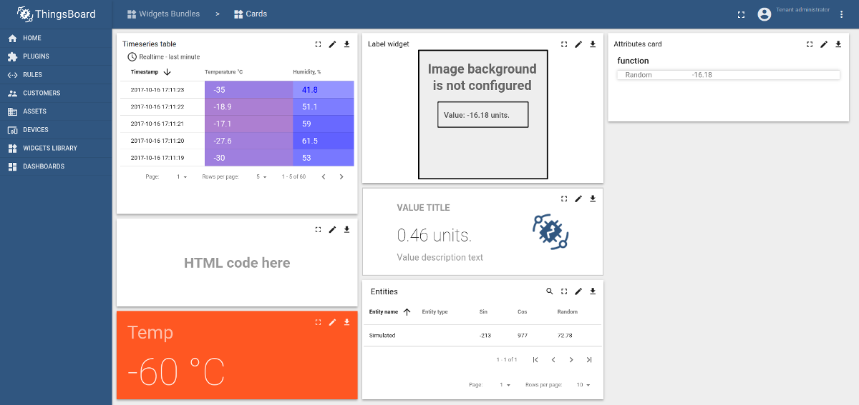
Cards
Useful for visualization of timeseries data or attributes in a table or card widget.

Slide 25
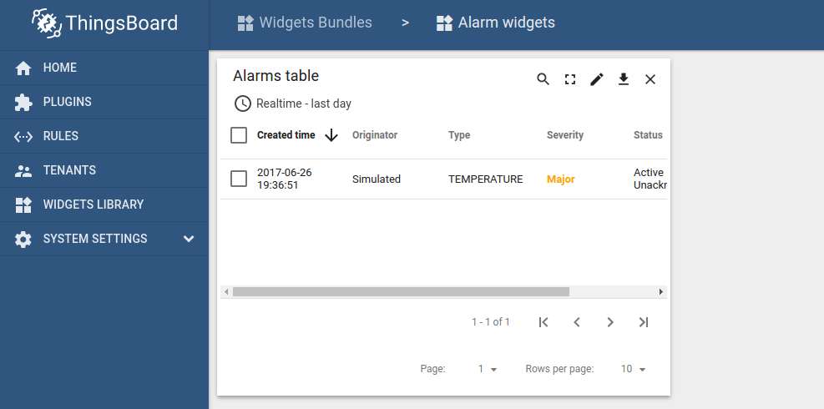
Alarm Widgets
Useful for visualization of alarms for specific entities both in real-time and history mode.

Slide 26
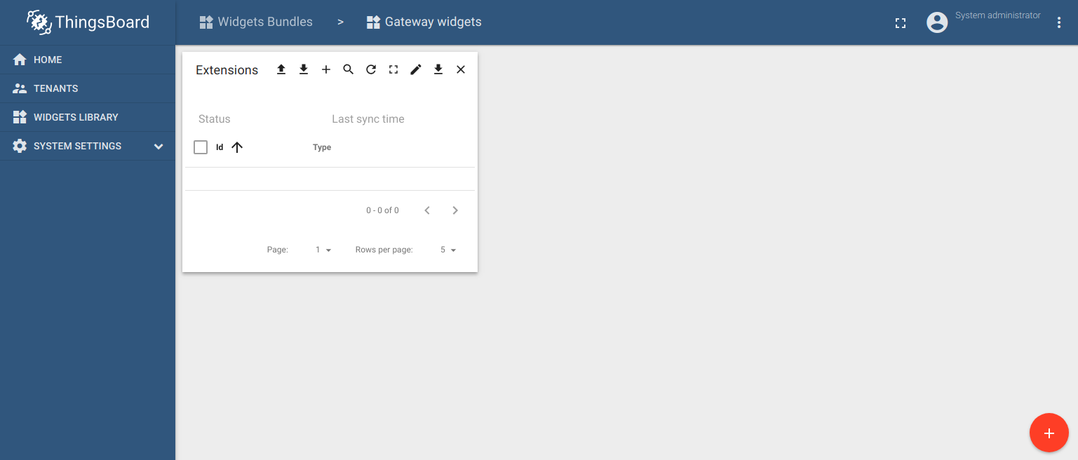
Gateway Widgets
Useful for managing extensions.

Slide 27
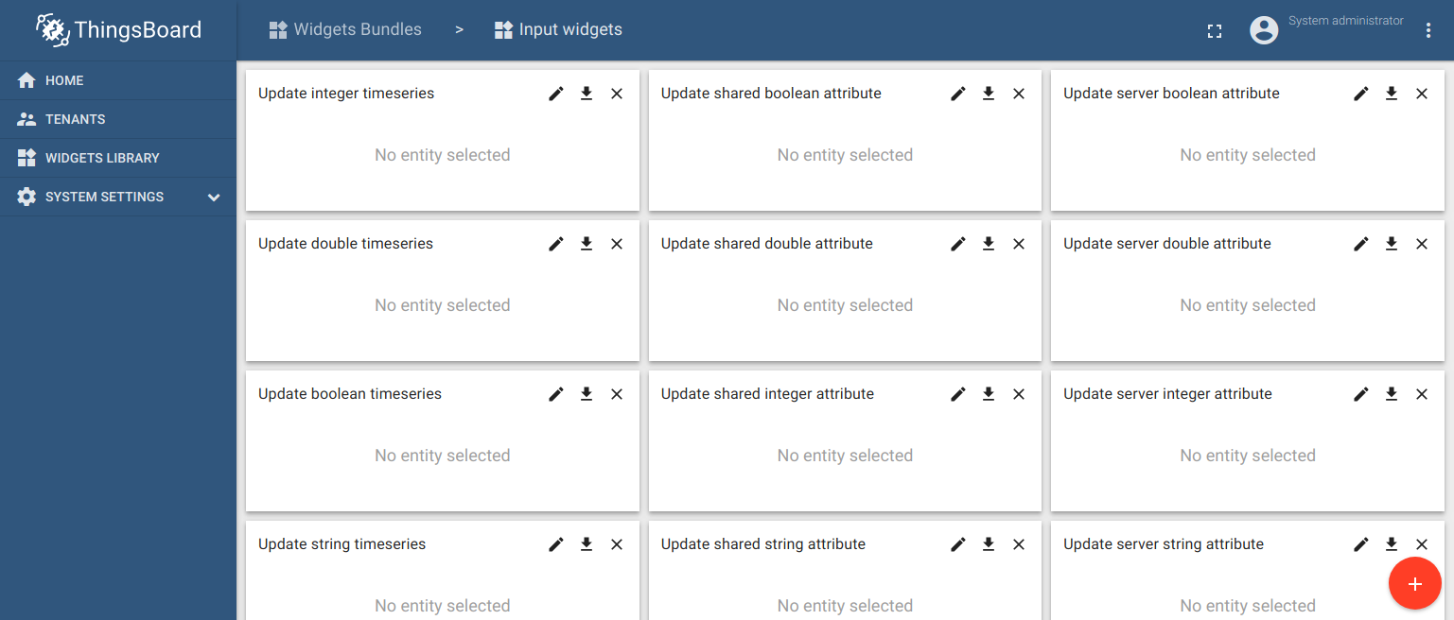
Input Widgets
Useful for changing entity attributes.

Slide 28
Widgets Bundles import/export

Slide 29
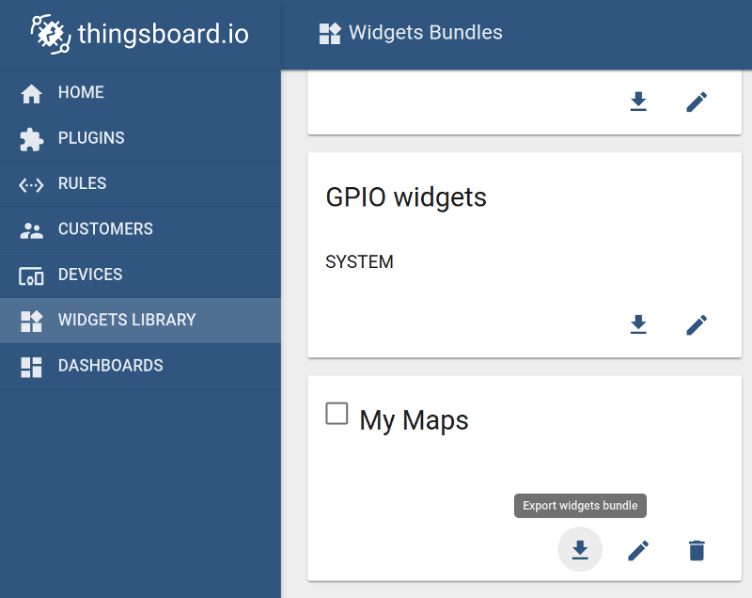
Widgets Bundles export
You are able to export widgets bundle to JSON format and import it to the same or another ThingsBoard instance.
In order to export widgets bundle, you should navigate to the Widgets Library page and click on the export button located on the particular widgets bundle card.

Slide 30
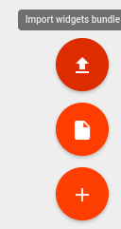
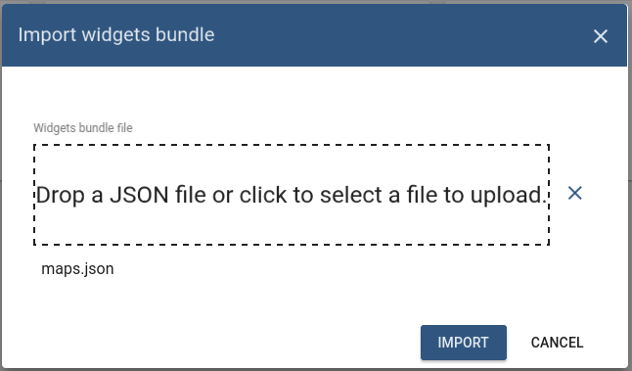
Widget Bundles Import
Similar, to import the widgets bundle you should navigate to the Widgets Library page and click on the big “+” button in the bottom-right part of the screen and then click on the import button.

Slide 31
Widgets Types import/export

Slide 32
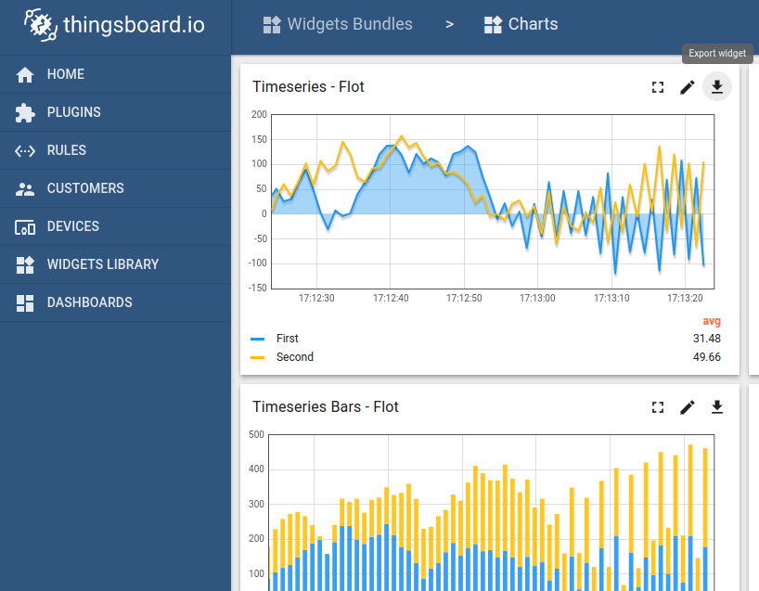
Widget Type export
You are able to export particular widget type from widgets bundle to JSON format and import it to the same or another ThingsBoard instance.
In order to export widget type, you should navigate to the Widgets Library page, then open desired widgets bundle and finally click on the export button located on the particular widget type card.

Slide 33
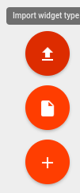
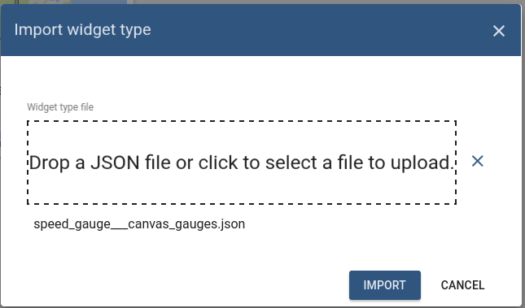
Widget Type import
Similar, to import the widget type you should navigate to the Widgets Library page, then open your widgets bundle and click on the big “+” button in the bottom-right part of the screen and then click on the import button.

Slide 34





IKUTI KAMI
digitalent.kominfo
digitalent.kominfo
DTS_kominfo
Digital Talent Scholarship 2019
Pusat Pengembangan Profesi dan Sertifikasi
Badan Penelitian dan Pengembangan SDM
Kementerian Komunikasi dan Informatika
Jl. Medan Merdeka Barat No. 9
(Gd. Belakang Lt. 4 - 5)
Jakarta Pusat, 10110
digitalent.kominfo.go.id

